Slide 1
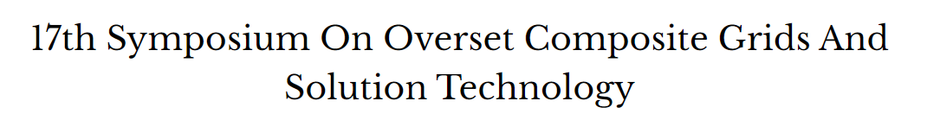
Application of High-Order Embedded Refinement Zones to IDDES Prediction of Tip-Vortex Cavitation Inception Using SUGGAR++/DiRTlib
Jeremy Koncoski, David Boger, Robert Kunz
Applied Research Laboratory and Department of Mechanical Engineering, Pennsylvania State University
Notes:
Opening: This presentation focuses on the overset technology that made the IDDES practical. The central question is how to place LES-level resolution only where the intermittent tip-vortex pressure minima are created and convected.

Slide 2
Overview
Tip-vortex cavitation inception and its resolution requirements
Why embedded overset refinement was selected
SUGGAR++ domain assembly and DiRTlib interpolation
Interface behavior, validation, and remaining limitations
Notes:
The presentation moves from the physical problem to the composite-grid architecture, then separates the responsibilities of SUGGAR++ and DiRTlib before assessing accuracy and limitations.

Slide 3
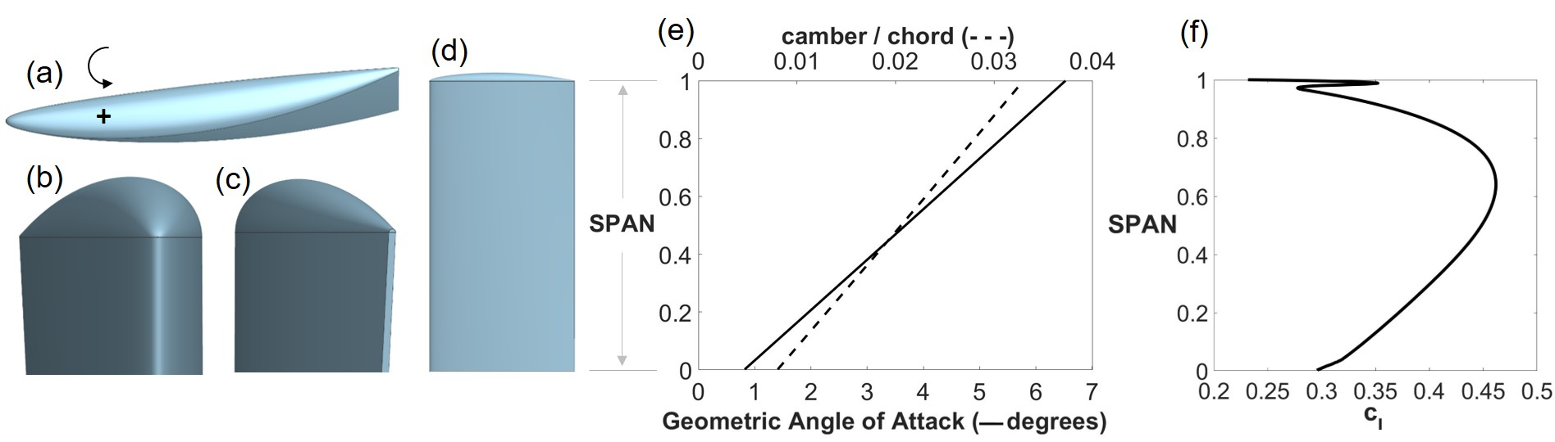
Tip-vortex cavitation inception
Inception follows rare instantaneous pressure minima rather than the mean vortex pressure
RANS cannot represent the intermittent turbulent structures that control those minima
Wall-resolved LES at Re_{c} = 1.3 × 10⁶ would be prohibitively expensive
Notes:
Sources: PoF manuscript, Abstract and Introduction; thesis, Chapter 1. The measured inception occurred downstream of the trailing edge and was intermittent.

Slide 4
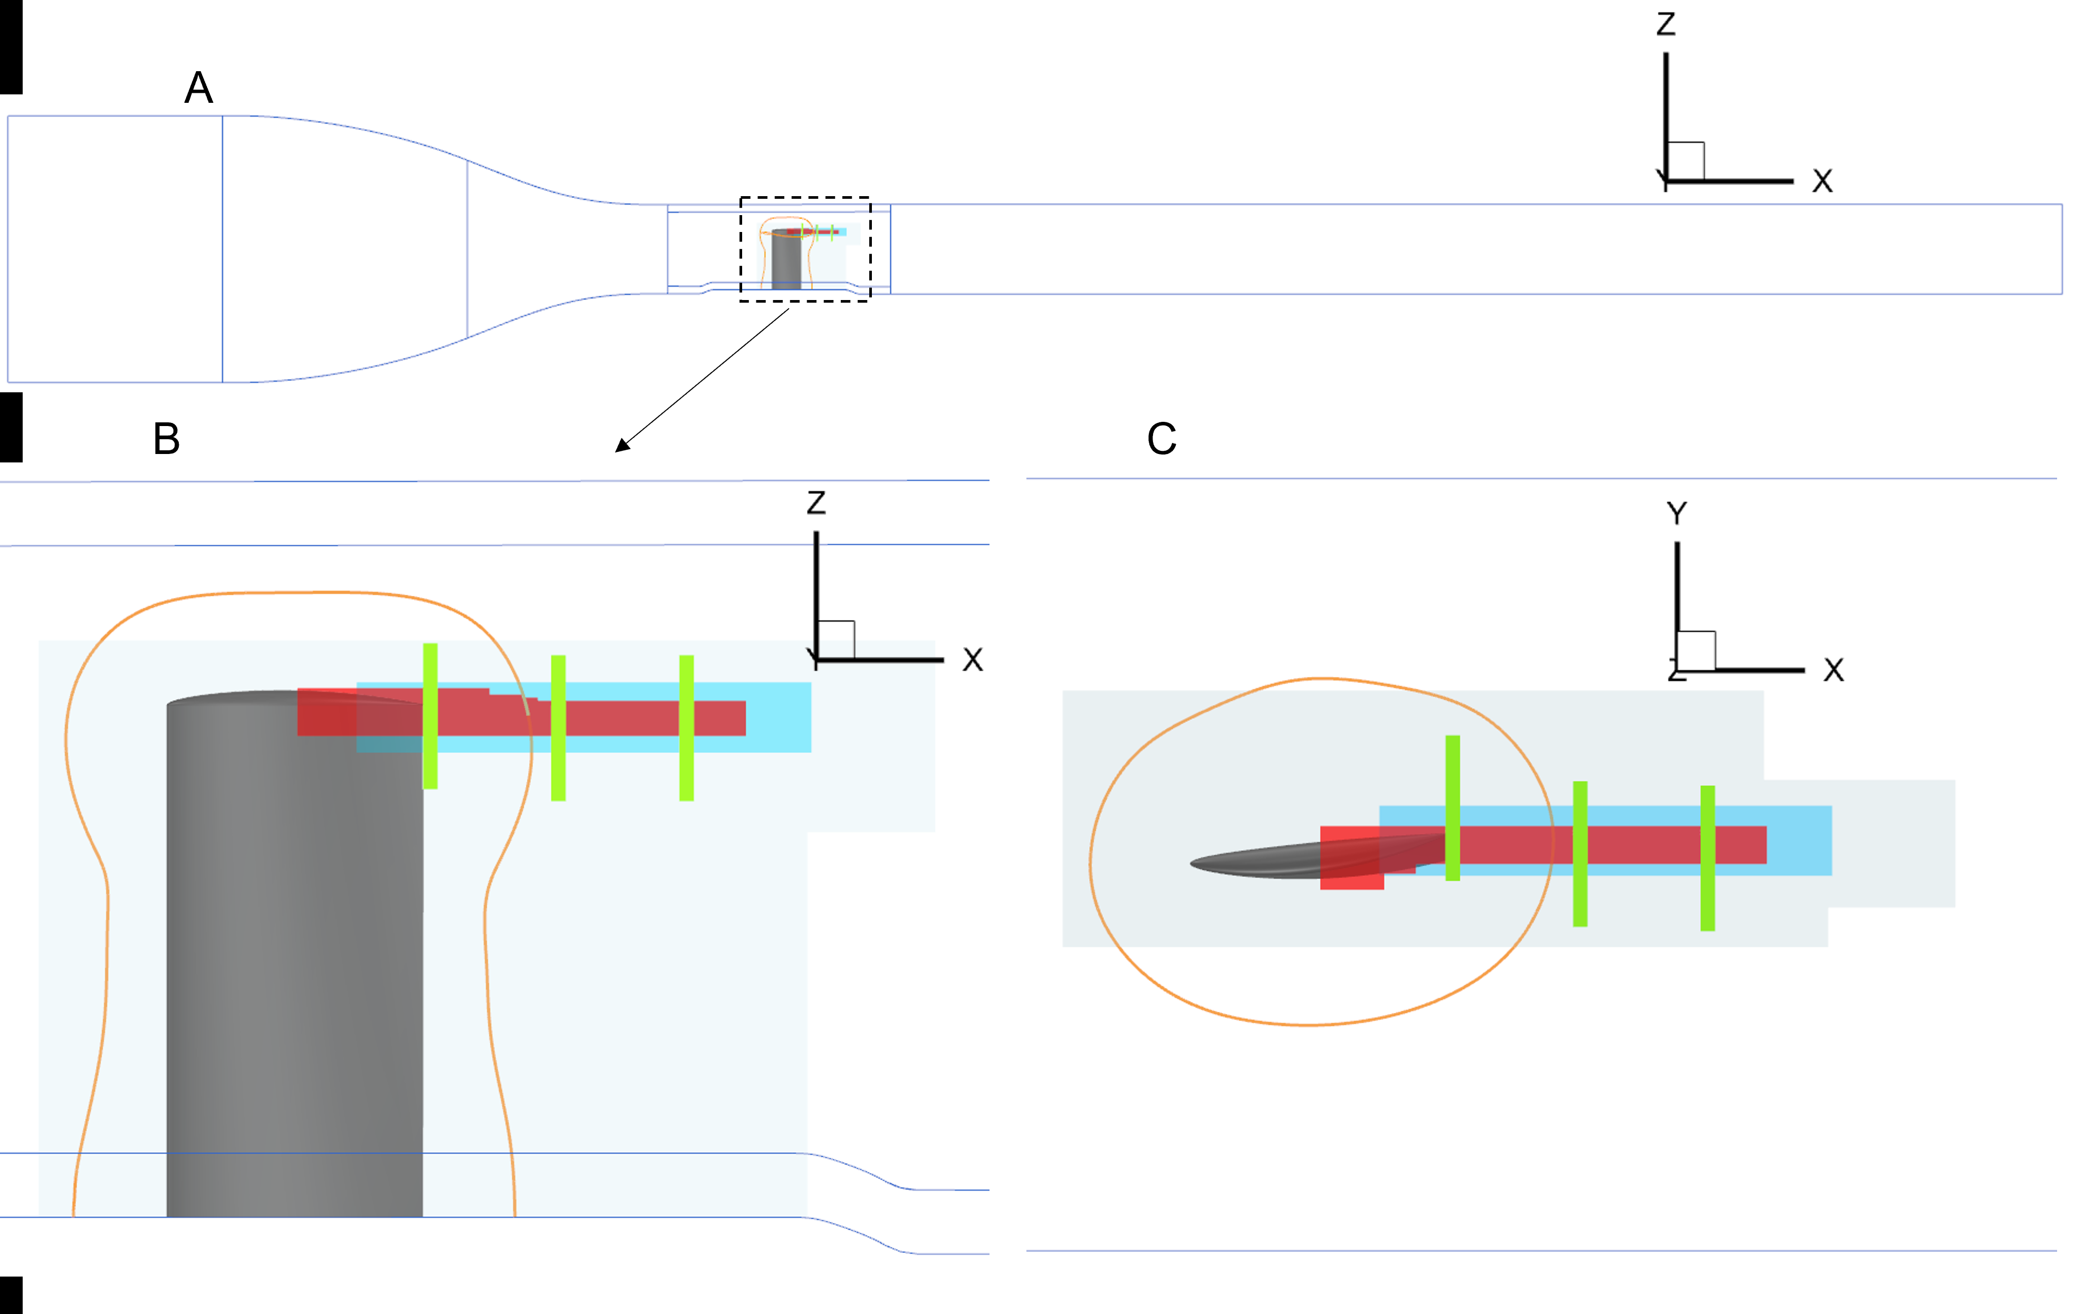
Why embedded overset refinement
The tunnel and hydrofoil require body-fitted near-wall grids
The vortex core benefits from uniform Cartesian cells and low numerical dissipation
Only a small fraction of the tunnel controls cavitation inception
Overset assembly decouples local resolution from the body-fitted topology
Notes:
Source: PoF manuscript, Section 4 and Figure 2. Overset refinement concentrates the cost in the tip vortex and wake while retaining suitable grids for the tunnel and hydrofoil walls.

Slide 5
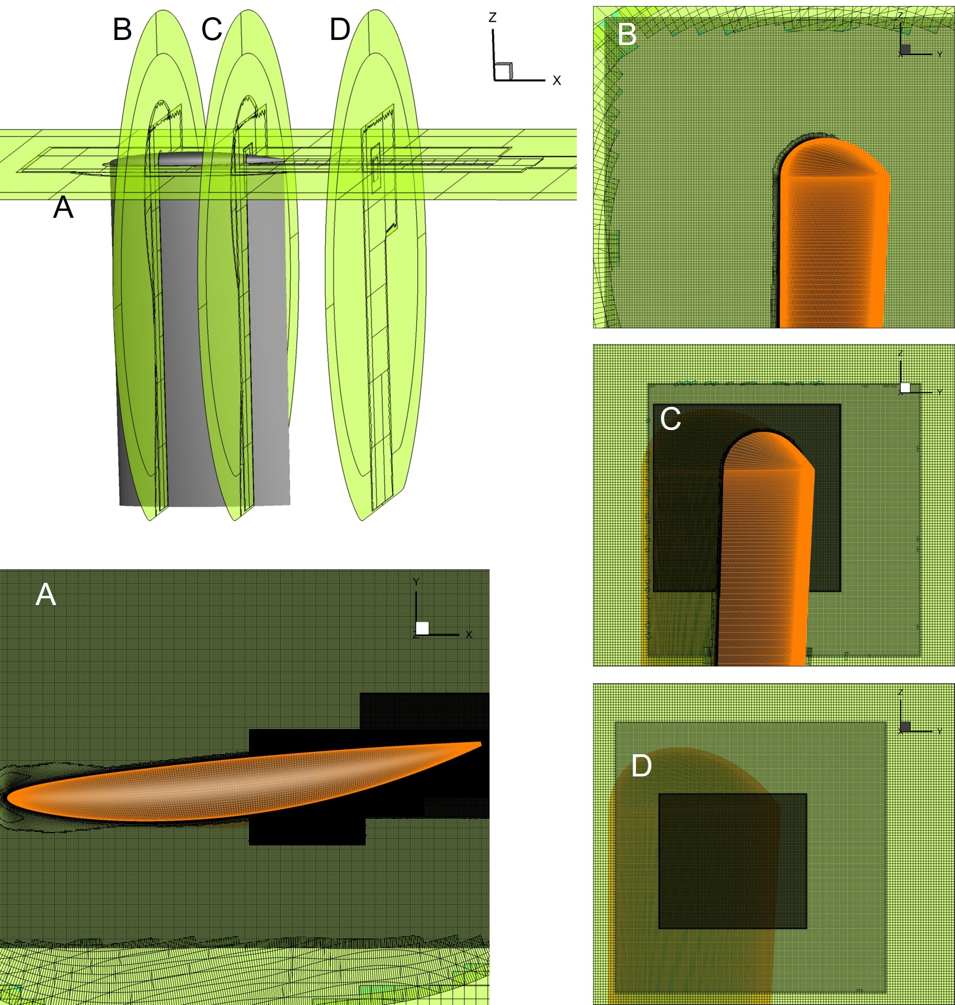
IDDES and overset division of labor
Body-fitted hydrofoil grid
Sublayer-resolved RANS with y⁺ ≤ 1
Chordwise spacing selected to avoid modeled-stress depletion
Cartesian vortex grids
LES-resolved tip vortex and wake
Central-biased differencing with nested 2:1 refinement
Notes:
Source: PoF manuscript, Sections 3.4 and 4; thesis, Section 2.4.1. IDDES retains near-wall RANS while embedded Cartesian grids support resolved turbulence in the vortex.

Slide 6
Composite-grid architecture
3
3
522M
Principal grid families
Tunnel, hydrofoil, vortex refinement
Cartesian refinement levels
Coarse, medium, fine
Active cells after trimming
Notes:
Source: PoF manuscript, Figure 2 and Table 1. Separate structured components retain their internal block connectivity; overset interpolation joins tunnel, hydrofoil, and vortex components.

Slide 7
Overset assembly
Background grid
Hole points
Excluded from the flow solve where another grid or solid owns the region
Body-fitted grid
Refinement grid
Fringe or receptor points
Receive interpolated solution values from donor cells on an overlapping component
DCI = hole status + receptor locations + donor stencils and weights
Notes:
The domain connectivity information, or DCI, defines excluded points, intergrid-boundary points, and donor interpolation data. Source: Noack et al., AIAA 2009-3992; Celeritas SUGGAR++ overset-process documentation.

Slide 8
SUGGAR++ constructs the domain connectivity
Component grids
Hole cutting
Donor search
DCI output
Finds donor cells for every fringe point and ranks suitable donors
Builds interpolation stencils consistent with the requested inviscid order
Minimizes overlap to reduce interpolated regions and active-cell cost
Supports efficient searches for uniform and stretched Cartesian grids
Notes:
Sources: PoF manuscript, Section 3.4; thesis, Section 2.4.1; Noack, Boger, Kunz, and Carrica, “SUGGAR++: An improved general overset grid assembly capability,” AIAA 2009-3992, doi:10.2514/6.2009-3992.

Slide 9
DiRTlib executes intergrid interpolation
DiRTlib
Flow solver arrays
Receptor values
Uses the SUGGAR++ DCI
Encapsulates donor gathering, communication, interpolation, and receptor scattering
Keeps overset operations solver neutral and limits changes to the flow solver
Interpolates the dependent variables at each solver update using the precomputed connectivity
Notes:
Sources: PoF manuscript, Section 3.4; Noack, “DiRTlib: A Library to Add an Overset Capability to Your Flow Solver,” AIAA 2005-5116. DiRTlib separates overset communication and interpolation from the solver’s physics and linear-solver logic.

Slide 10
Static overset workflow used in the IDDES
Tunnel, hydrofoil, and vortex grids
SUGGAR++ assembly
DCI
Flow solver + DiRTlib
One-time preprocessing
Each physical time step
Trim inactive cells
Select donor stencils and weights
Write connectivity for the static configuration
Advance the block-implicit finite-volume equations
Exchange dependent variables across overset interfaces
Converge dual-time iterations, then accumulate statistics
Notes:
The current hydrofoil configuration is static, so SUGGAR++ generates connectivity during preprocessing. DiRTlib applies that connectivity during the time-accurate solution.

Slide 11
Trimmed composite grid
Tunnel background grid surrounds the hydrofoil and embedded Cartesian zones
The hydrofoil component retains wall-normal clustering and surface alignment
Overset trimming removes inactive cells while preserving sufficient overlap
Notes:
Source: PoF manuscript, Figure 3; thesis, Figure 2.5. The orange surface grid and nested Cartesian blocks remain independent components after assembly.

Slide 12
Three nested vortex-refinement levels
Component | Active cells | Δ/c | Downstream extent
Tunnel | 9.0M | 0.022 | Full domain
Hydrofoil | 10.8M | ≤ 0.005 | Body fitted
Coarse vortex | 300M | 0.0025 | 2.0c
Medium vortex | 46M | 0.00125 | 1.5c
Fine vortex | 156M | 0.000625 | 1.25c
Each level halves the cell dimension
The finest block follows vortex formation and extends through the experimental measurement region.
Notes:
Source: PoF manuscript, Table 1 and Section 4. Cell dimensions differ by exactly 2:1 between nested vortex blocks.

Slide 13
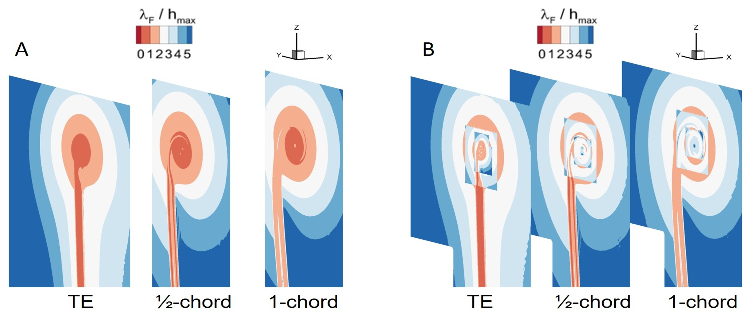

Grid design criteria
RANS estimates targeted λ_{F} / h_{max} ≥ 2 near the vortex core
Approximately 60 cells resolve the vortex core at the measurement planes
Hydrofoil y⁺ ≤ 1 supports sublayer-resolved RANS
Excessive surface refinement was rejected after modeled-stress depletion reduced lift by about 20%
Initial coarse vortex-grid RANS scoping calculation
Final refined vortex-grid. Cell dimension is ¼ of that in A
longitudinal Taylor microscale
Resolution planning balanced DES shielding, turbulence resolution, and overset-interface placement
Notes:
Sources: PoF manuscript, Sections 4 and 5.1; Figure 7. The near-wall mesh could not be refined independently of the IDDES behavior because overly fine tangential spacing triggered modeled-stress depletion.

Slide 14
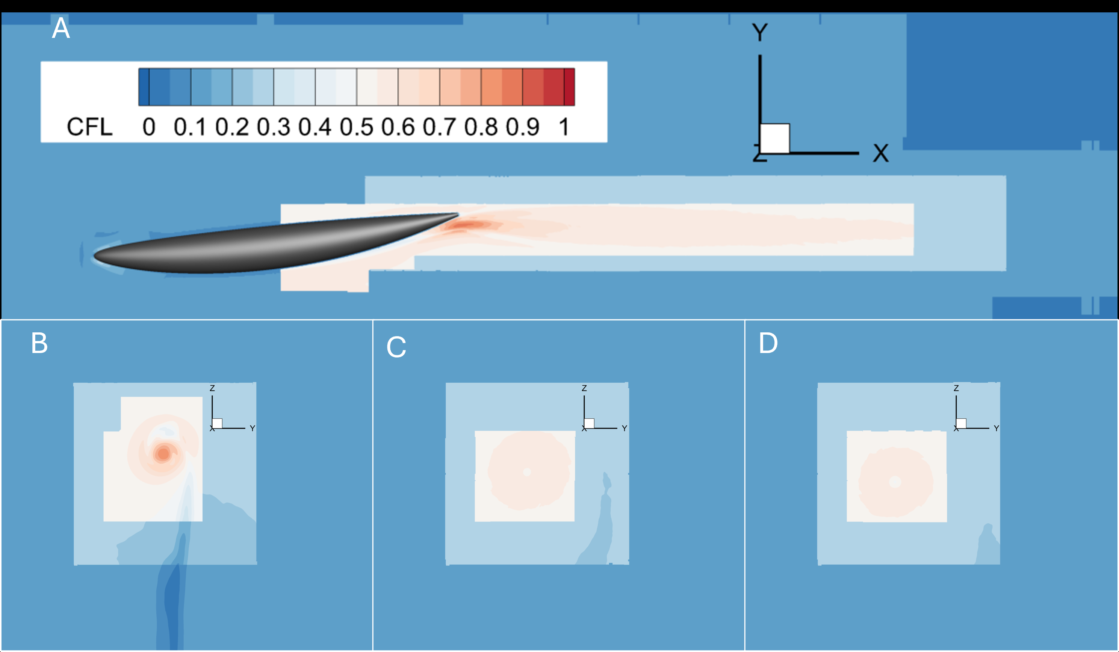
Numerical method and time step
7th
2nd
order spatial accuracy
weighted MUSCL
order backward
time integration
3.24 μs
0.55
physical time step
mean CFL in
the finest grid
Blended central-upwind differencing inside the Cartesian refinement zones limits numerical dissipation while maintaining stability
Notes:
Source: PoF manuscript, Sections 3.4 and 4, Figure 4, Table 2. The worst-case CFL was approximately 0.87 near the trailing edge.

Slide 15
Overset interfaces create abrupt CFL changes
2:1 spacing changes produce visible contour steps at overset boundaries
The chosen Δt keeps CFL below unity, including the finest vortex block
Notes:
Source: PoF manuscript, Figure 4. Interface placement and time step selection must be considered together because each 2:1 grid transition changes the local CFL and interpolation error.

Slide 16
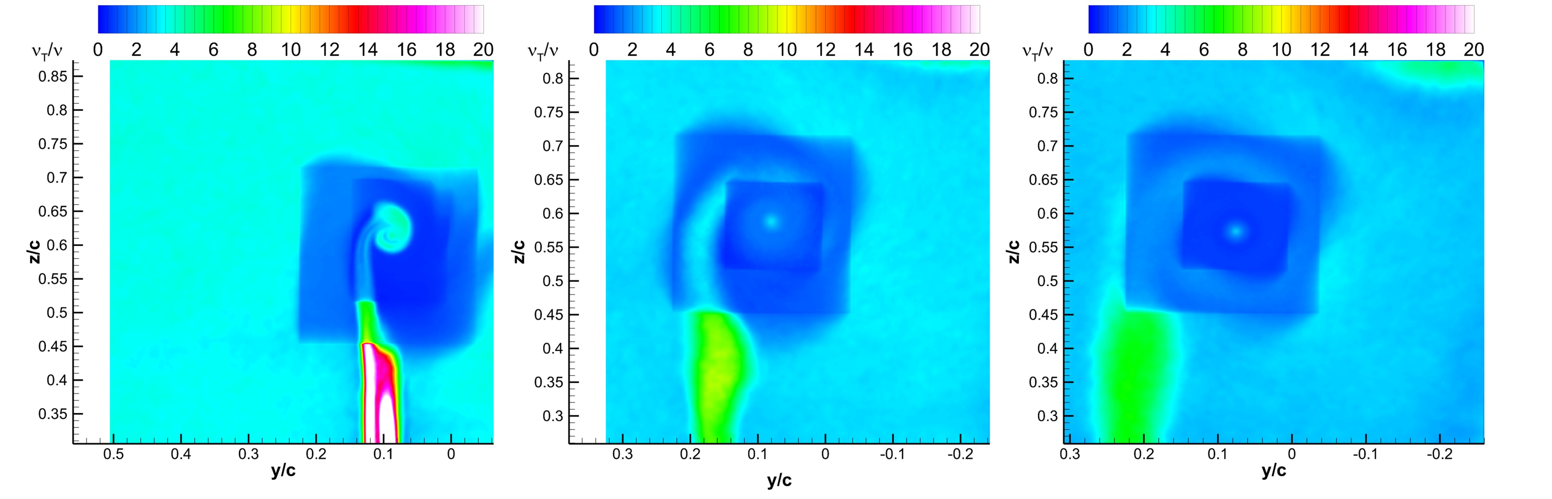
Resolved turbulence across refinement interfaces
QTKE steps reveal the refinement boundaries
ν_{t}/ν remains low inside the resolved vortex core
Notes:
Sources: PoF manuscript, Figures 8 and 9. Grid boundaries remain visible in resolved-TKE measures, including a rotated imprint as flow turns through the vortex.

Slide 17
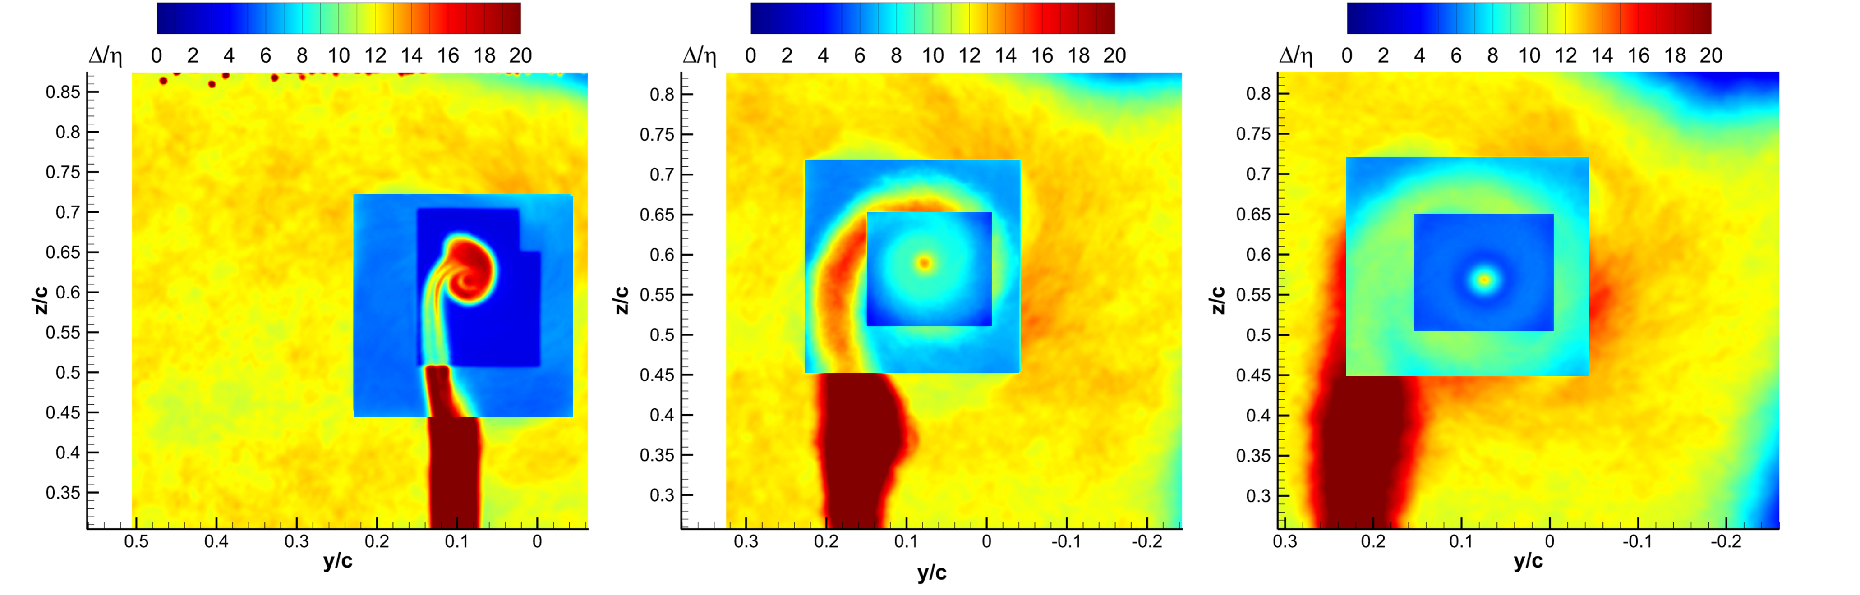
Vortex resolution and solution quality
56–68
cells across the mean vortex core
3–9
Δ/η near the vortex-core edge
2.6–4.3
peak ν_{t}/ν at the ensemble vortex center
The simulation resolves the large energetic motions and models the smallest scales
Notes:
Sources: PoF manuscript, Sections 5.2–5.4 and Figure 10. Core-center Δ/η was 10–14 downstream and 13–18.6 near the trailing edge.

Slide 18
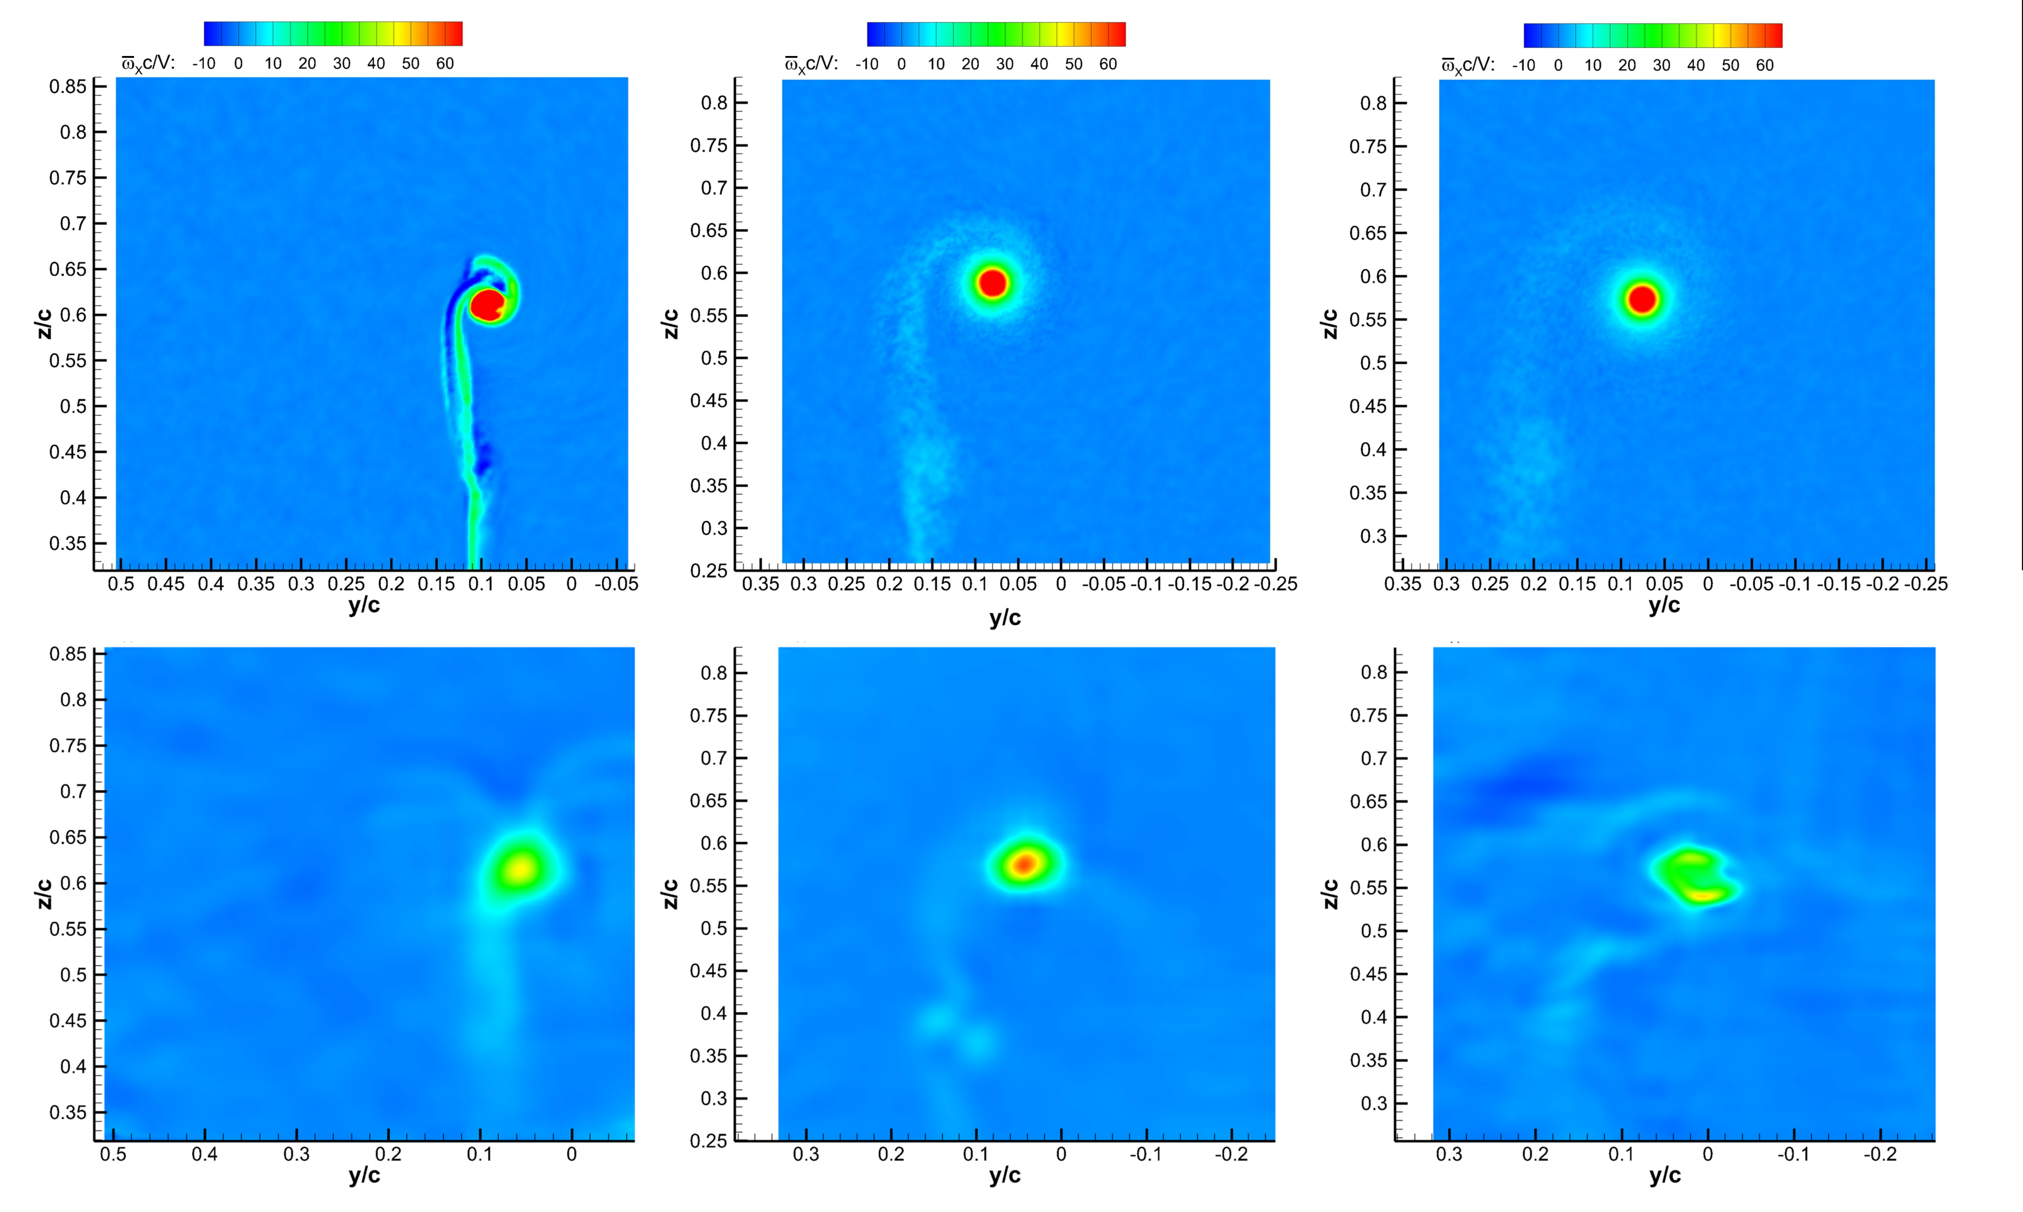
Validation and cavitation-inception evidence
3.3%
difference between predicted and measured mean lift
4.4–4.6
measured acoustic inception cavitation index
The IDDES reproduces the principal vortex topology and downstream evolution, then generates intermittent pressure minima consistent with measured inception limits.
Notes:
Sources: PoF manuscript, Sections 5.5, 6.2, and 6.4; Figures 13 and 19–23. Predicted C_L = 0.402 ± 0.012 versus measured C_L = 0.388 ± 0.003.

Slide 19
Effectiveness and remaining limitations
What the overset strategy enabled
What still requires care
LES-level resolution in the vortex without global tunnel refinement
High-quality Cartesian cells through vortex roll-up and the SPIV planes
A practical 522-million-active-cell calculation at experimental Reynolds number
Interpolation and abrupt 2:1 changes leave signatures in CFL and resolved TKE
IDDES underpredicts downstream turbulence and vortex wandering
Further core refinement would increase both cell count and time-step cost substantially
Overset refinement reduced cost without removing the need to quantify interface effects
Notes:
Sources: talk abstract; PoF manuscript, Conclusions. The main limitations include interface signatures, reduced vortex wandering, underpredicted turbulent stresses, and the remaining modeled contribution in the vortex core.

Slide 20
Summary
Overset topology separated near-wall RANS requirements from vortex-resolving LES requirements
SUGGAR++ assembled the composite grid and produced high-order domain connectivity information
DiRTlib applied the connectivity and transferred dependent variables during the solution
Nested 2:1 Cartesian refinement resolved the vortex core while limiting global cost
Validation supports the approach, while interface effects and downstream turbulence remain active concerns
Embedded overset refinement made a scale-resolving cavitation-inception calculation feasible at laboratory Reynolds number.
Notes:
Closing message: the overset system was not merely a meshing convenience. It was the enabling technology that placed adequate resolution in the small region controlling cavitation inception while retaining a practical overall simulation.

